Slide 1
OOP Project Pokemon
for Teachrs
Hà Minh Trí - ITCSIU22194
Nguyễn Anh Trí - ITCSIU22152
Phan Đức Trí - ITCSIU22151
Đỗ Hùng Việt - ITCSIU22197

Slide 2
Table of contents
01.
02.
04.
03.
05.
Game Outline
Approach
DEMO
Diagram
Conclusion

Slide 3
01.
Game Outline

Slide 4
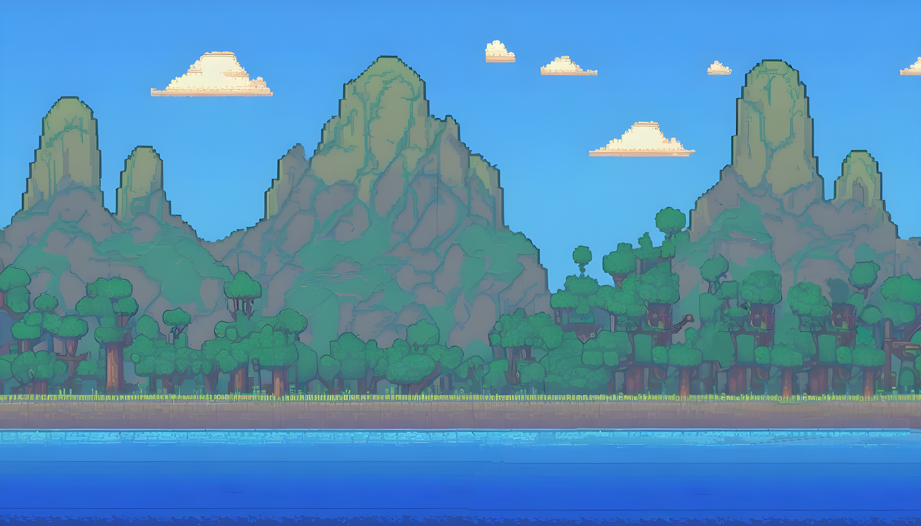
Introduction
2D Platform Pokemon boss fighting game
Inspired by Megaman

Slide 5
Features of the game
Character
Map
Mechanics

Slide 6
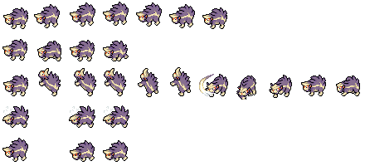
Character Sprite

Slide 7

Map

Slide 8
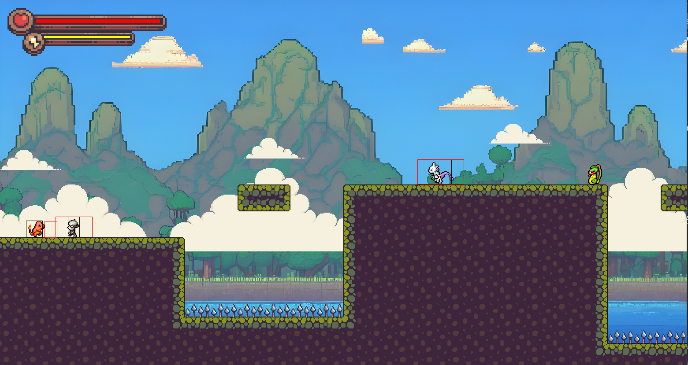
Mechanic

Slide 9
Mechanic
A
D
Space

Slide 10
02.
Approach

Slide 11


Mapping
Level 1
Level 2

Slide 12
03.
Diagram

Slide 13
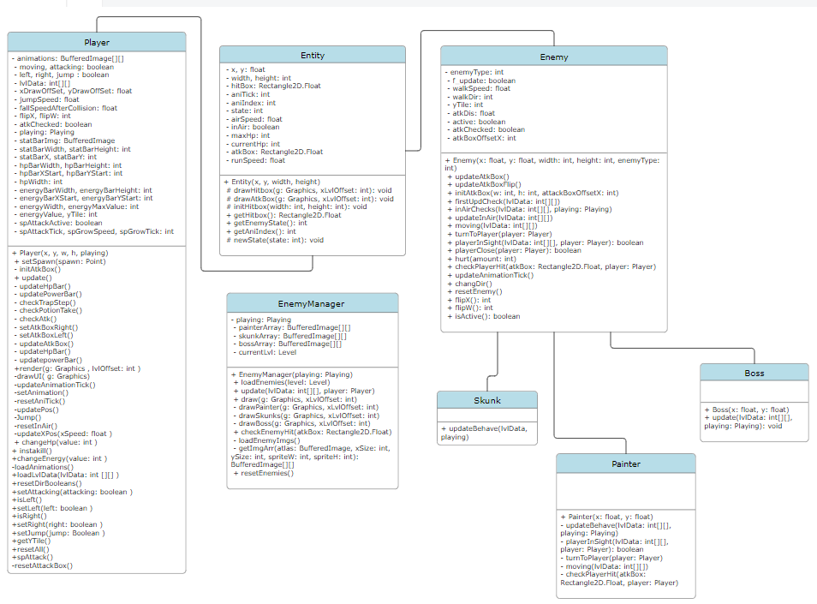
Entity

Slide 14
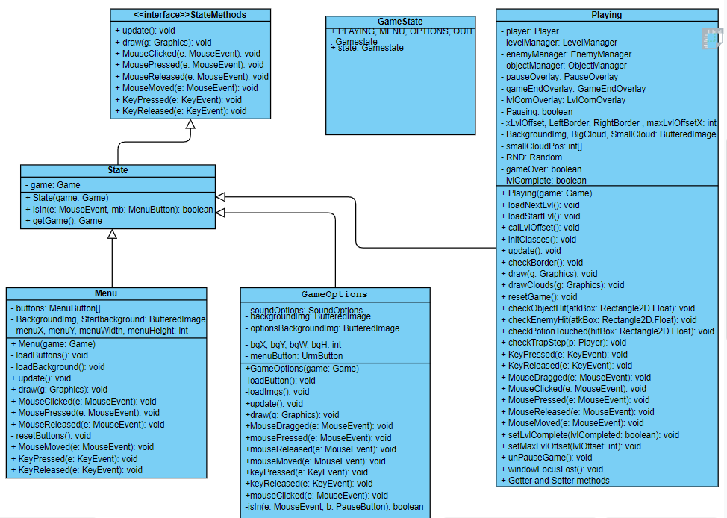
GameStates

Slide 15
04.
DEMO

Slide 16
05.
Conclusion

Slide 17
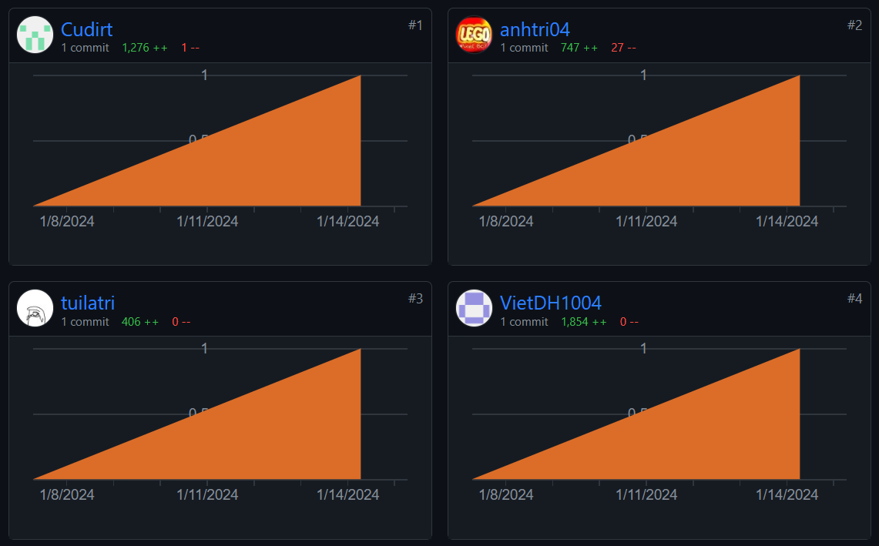
What we have achieved
1.
2.
3.
Design Diagram
Work as a team
Implement project
Implement the entire project onto Github

Slide 18
References
Platformer Tutorial - Java
https://www.youtube.com/playlist?list=PL4rzdwizLaxYmltJQRjq18a9gsSyEQQ-0

Slide 19
Thank You For Listening
THE END

